Slide 1
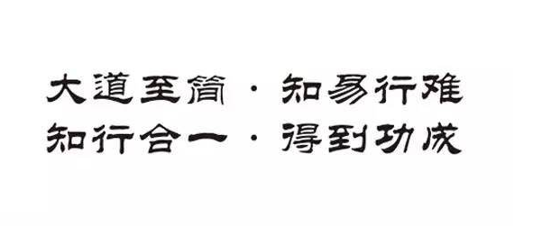
After reading all the documents of COE, programmer may know the concept, architecture, work flows, modules, data structures about COE. But I don't think it's enough, it must take a lot of practice to understand COE deeply. So start to practice, communicate, discuss, solve problem and build your CAD/CAM product!

